Slide 1
August 24, 2020

Slide 2
What Are We Presenting for ?
1
2
3

Slide 3
Why?
Pros/cons cloud bases versus self hosted.

Slide 4
Cloud Based
Pros
Less development time and long-term reduction in ongoing maintenance.
Additional email support for premium usage.
Metrics and analytics are included.
Cons
Cloud is more expensive.
Increased cost for private usage due to intellectual property impact.
- Usage monitoring based on number of hours based on selected package.
Notes:
Need to investigate shinyapps.io backup practice.

Slide 5
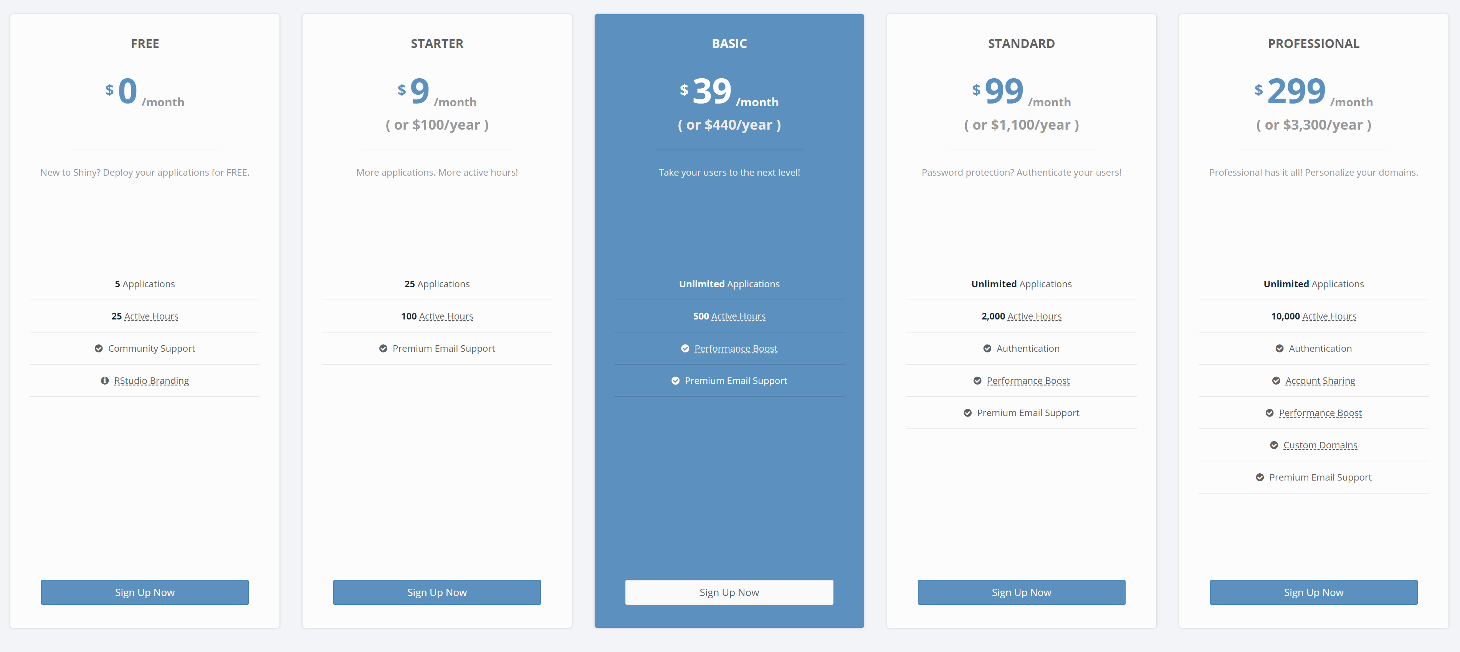
Cloud Based
Notes:
Need to investigate shinyapps.io backup practice.

Slide 6
Self based
Pros
Lower cost if existing servers are usable.
Cons
Storage/Memory
Deploying app will take longer and involve BCH resources.

Slide 7
Next Steps

Slide 8
Appendix

Slide 9
Other options considered

Slide 10
Resources

